Slide 1

Exoplanet Simulator 2000
NASA Space Apps challenge 2023
Habitable Exoplanets: Creating Worlds Beyond Our Own
Team CHeDDar
Andrea Brzica, Lobel Marunić, Ema Donev, Donna Keran

Slide 2
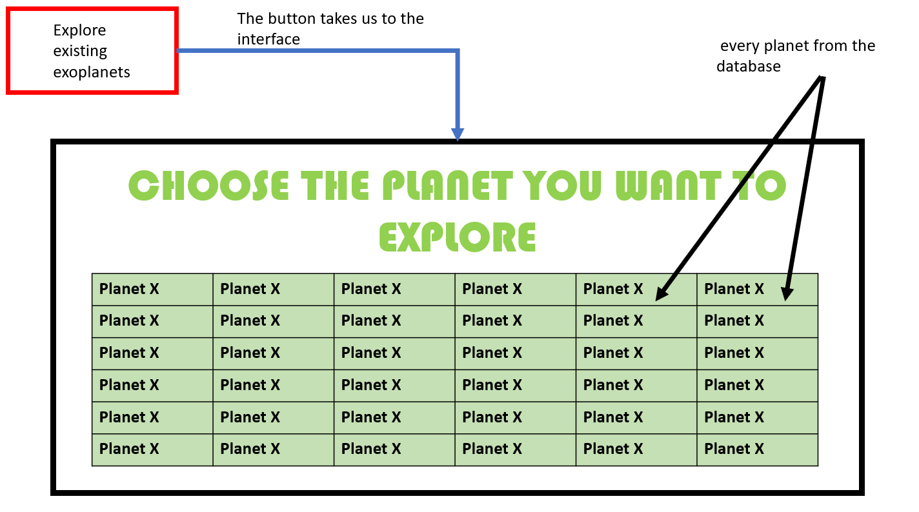
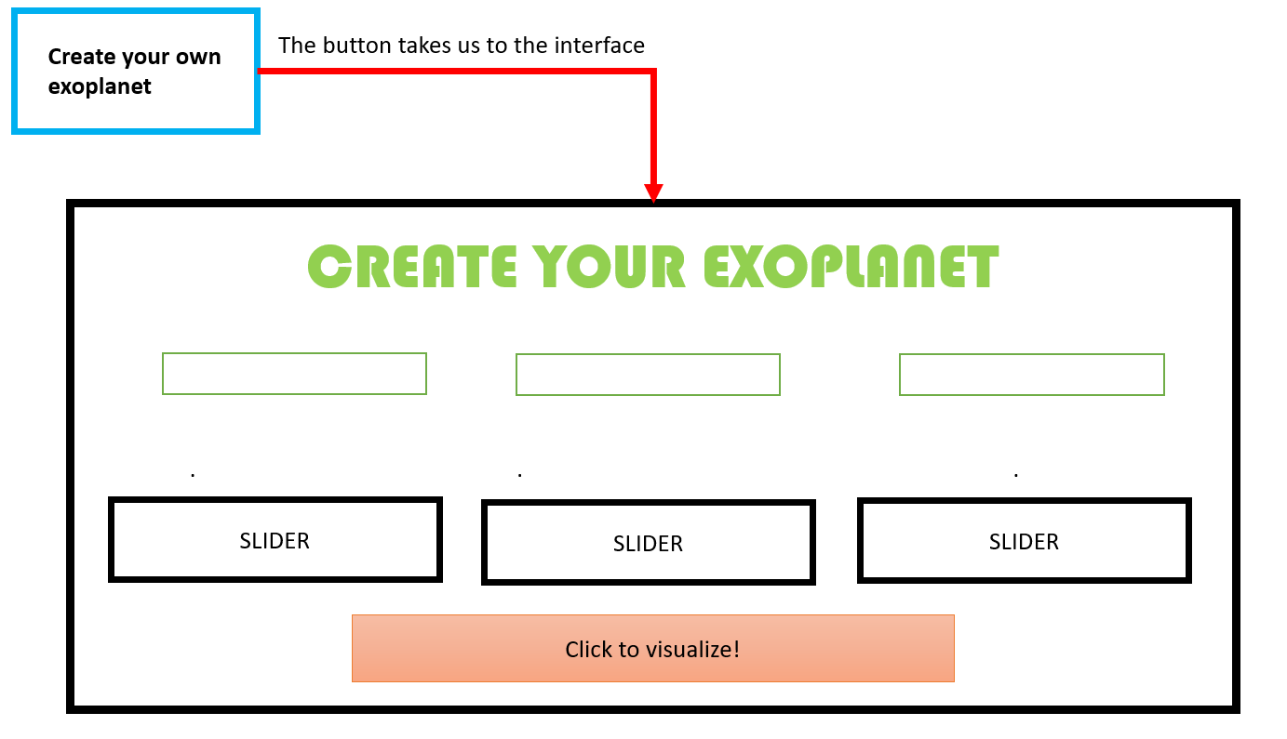
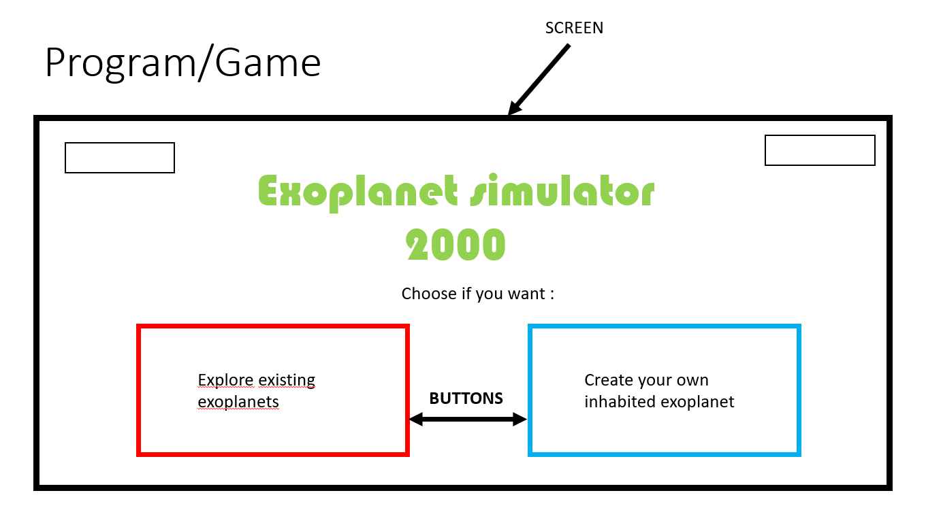
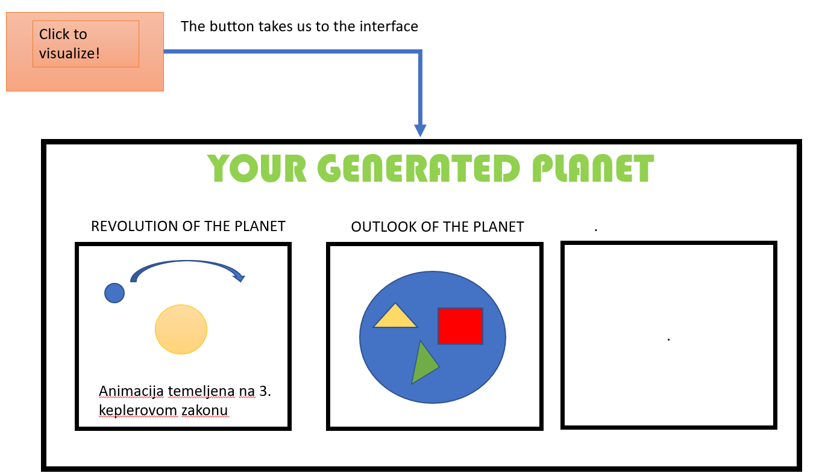
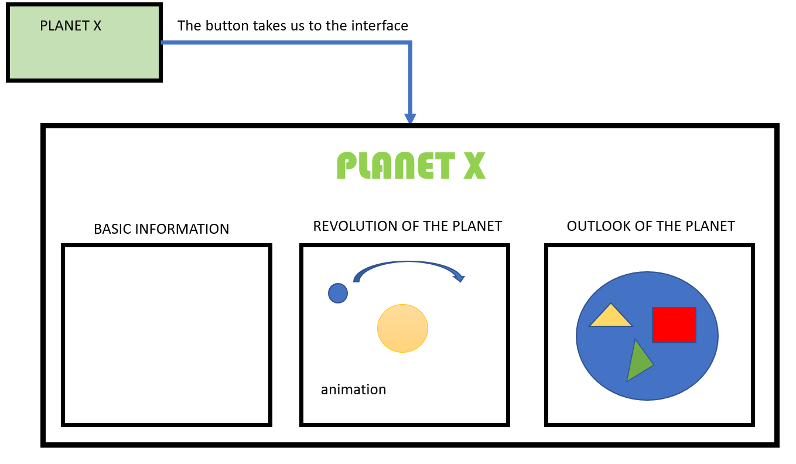
What did we develop?

Slide 3
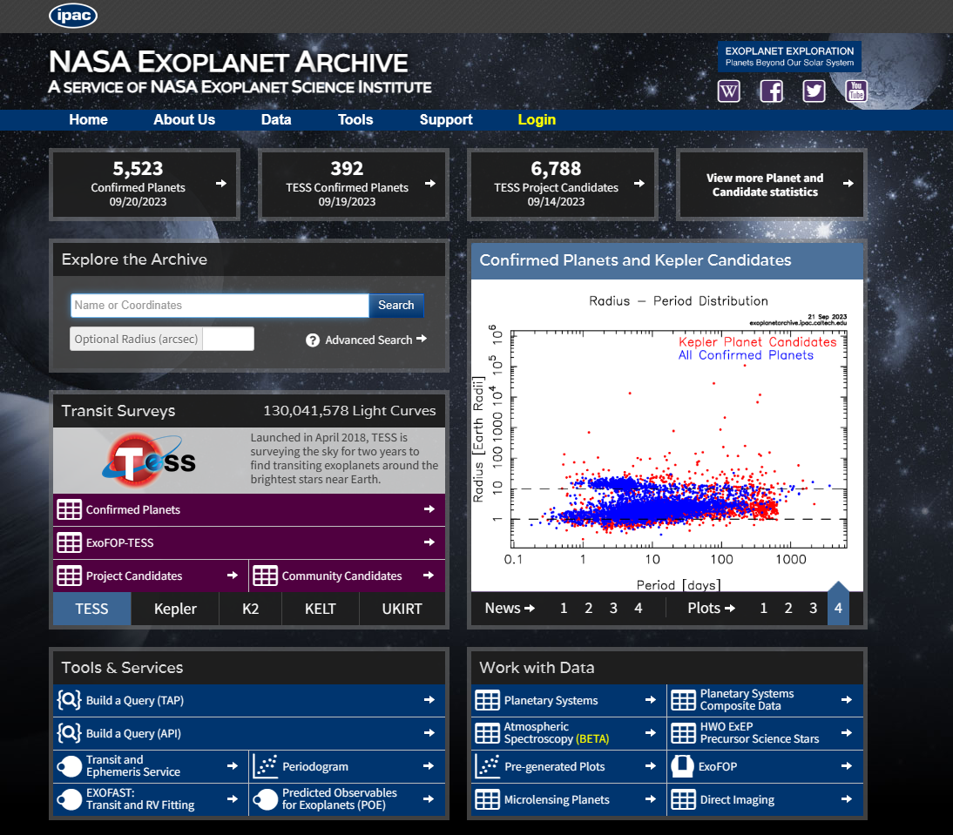
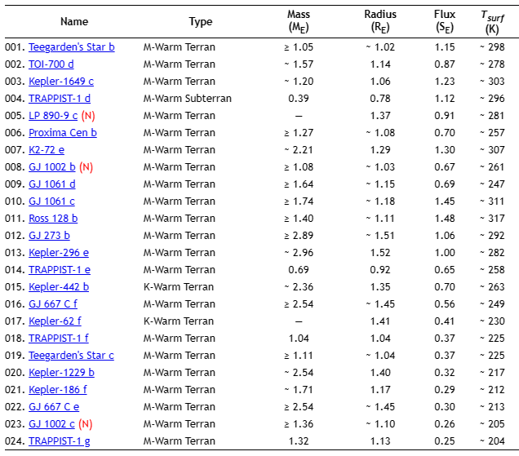
Table 1. List of potentially habitable exoplanets
Figure 2. NASA database interface layout

Slide 4
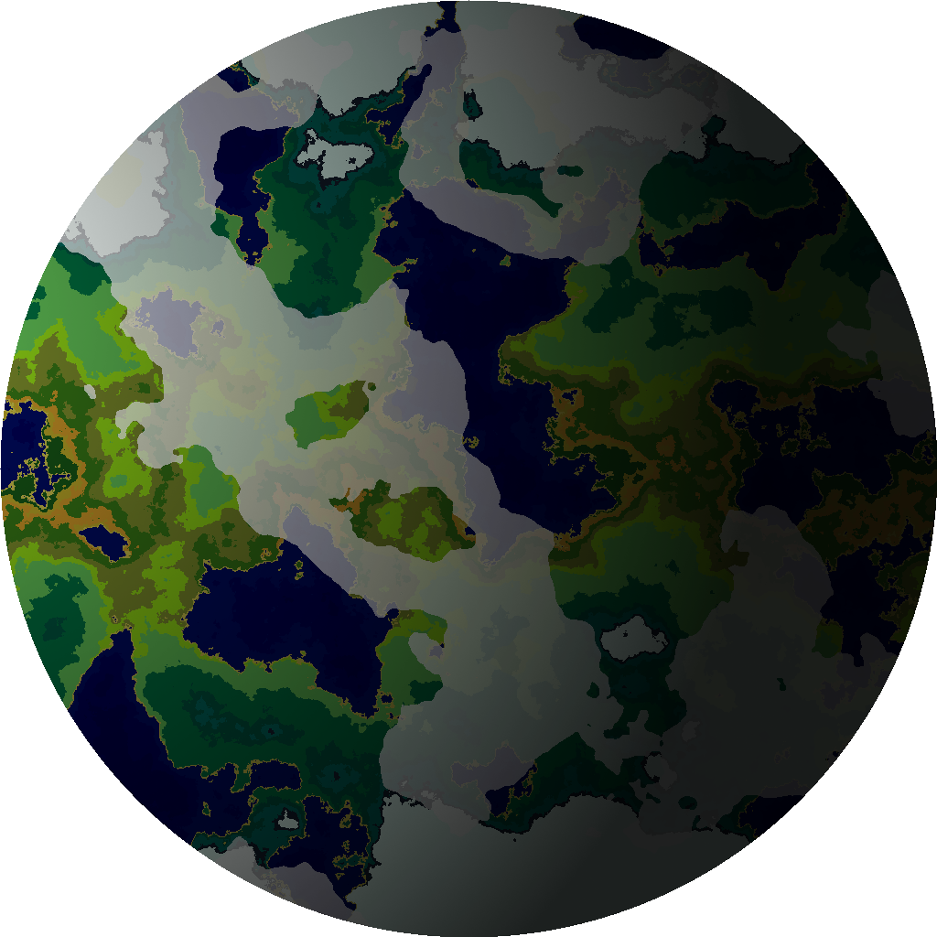
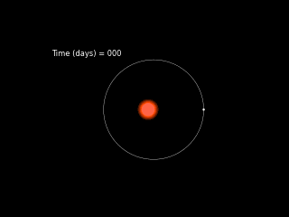
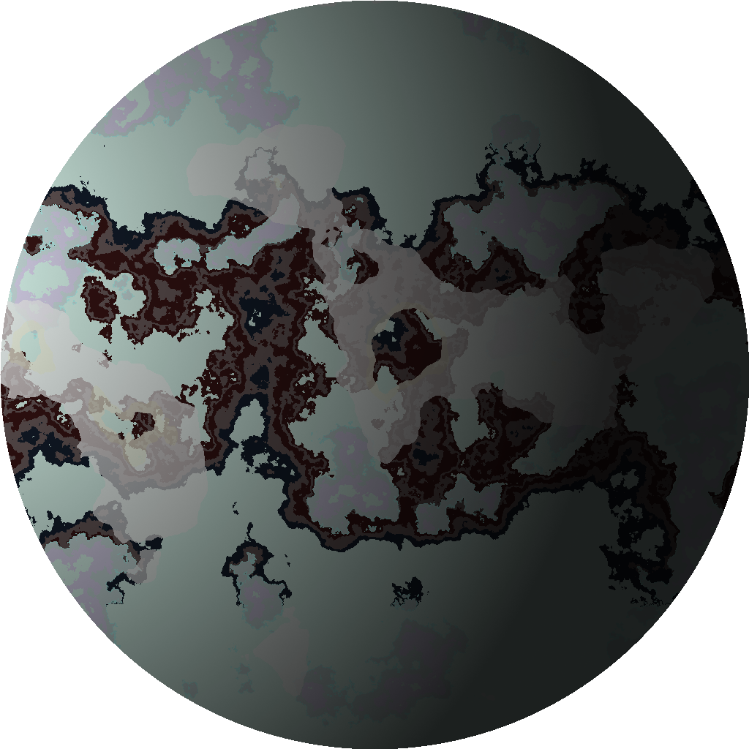

Simulating planetary systems
Simulating planetary surfaces
Use of Kepler’s 3rd law of planetary motion
$$\frac{4π^{2}}{GM}=\frac{T^{2}}{a^{3}}$$
Simulation takes into consideration
$$m_{p,s}, a, ε,$$
Procedural map generating by Python
„PlanetGenerator” by Kornel Szyska
Parameters accounted for:
surface temperature, gravitational accelaration, star spectral type

Slide 5
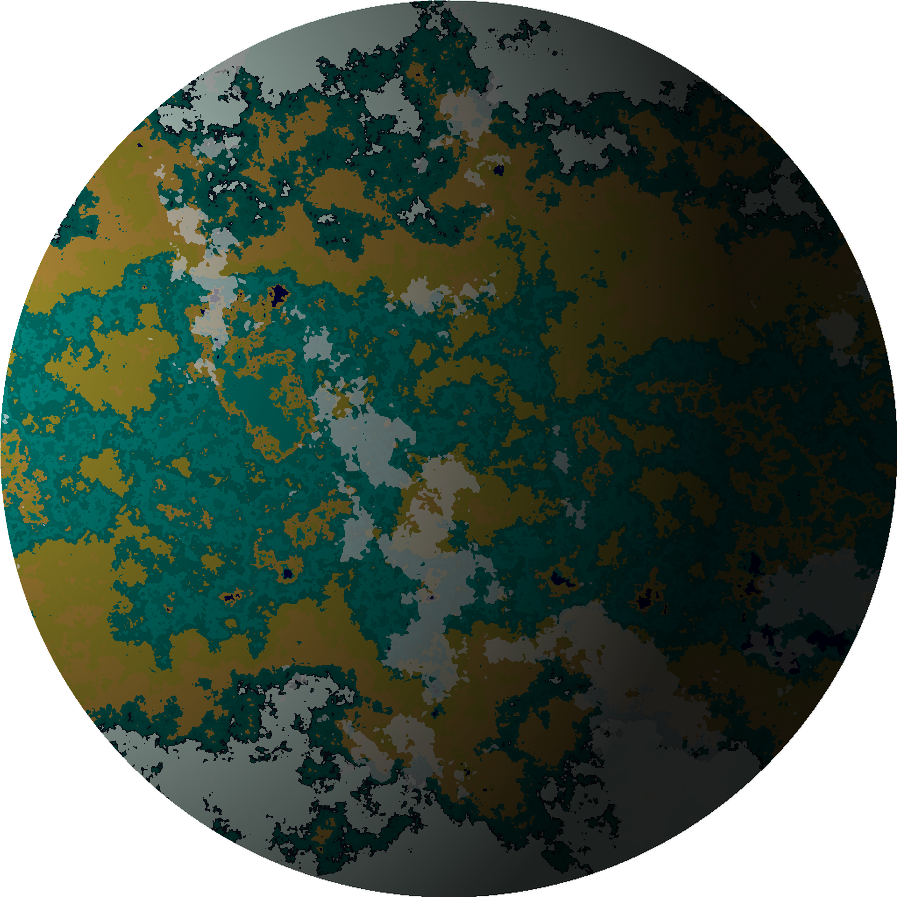
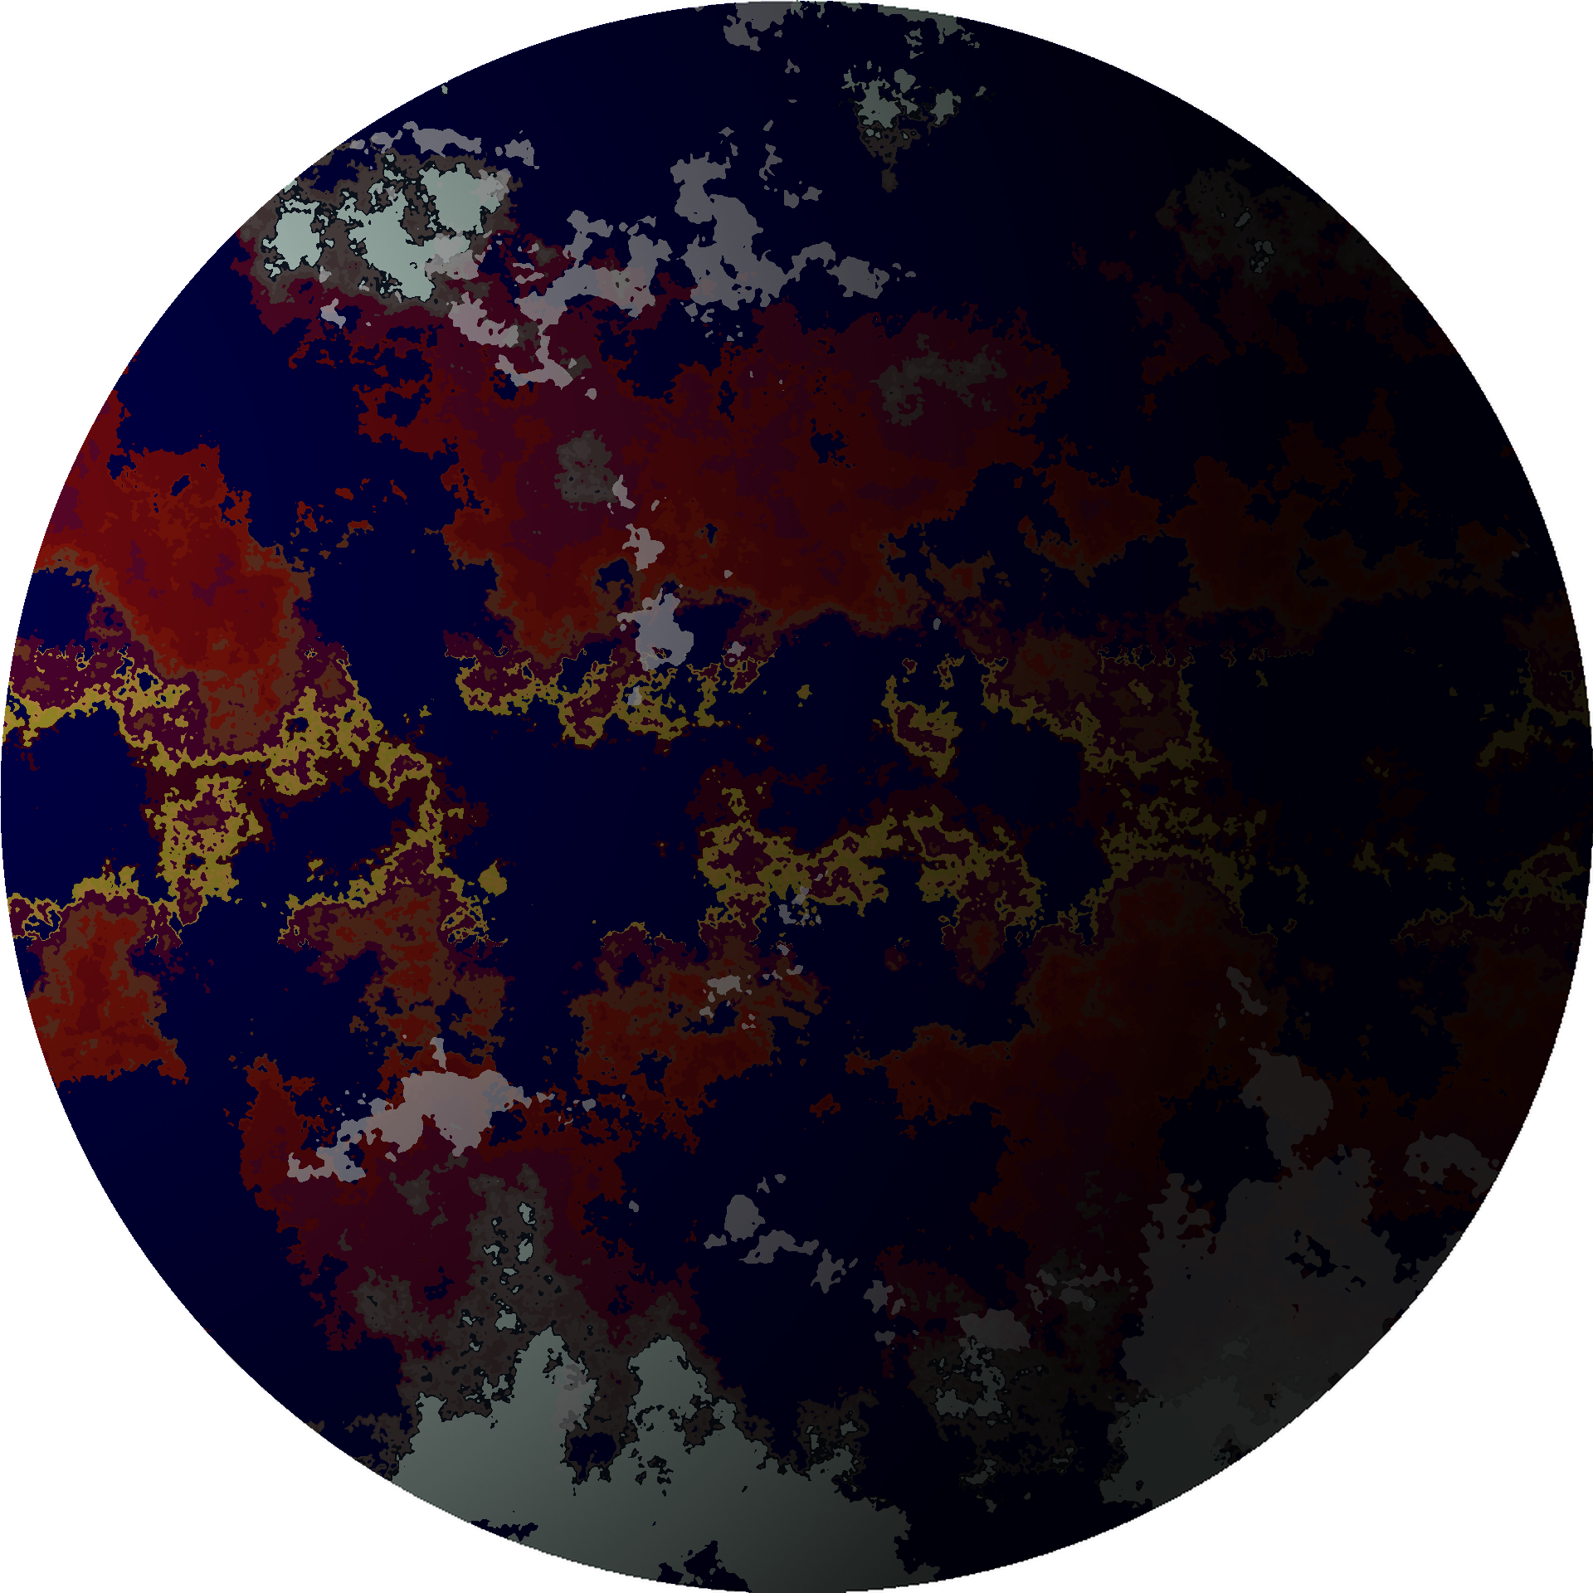


Input parameters:
$$T_{surface}=−15℃, { R}_{planet}=1{ R}_{earth}$$
$$M_{planet}=1{ M}_{earth}{, F}_{planet}=1{ F}_{earth}$$
$${Spectral type}_{star}=M$$
Input parameters:
$$T_{surface}=10 ℃, { R}_{planet}=1{ R}_{earth}$$
$$M_{planet}=1{.5 M}_{earth}{, F}_{planet}=1{ F}_{earth}$$
$${Spectral type}_{star}=F$$

Slide 6
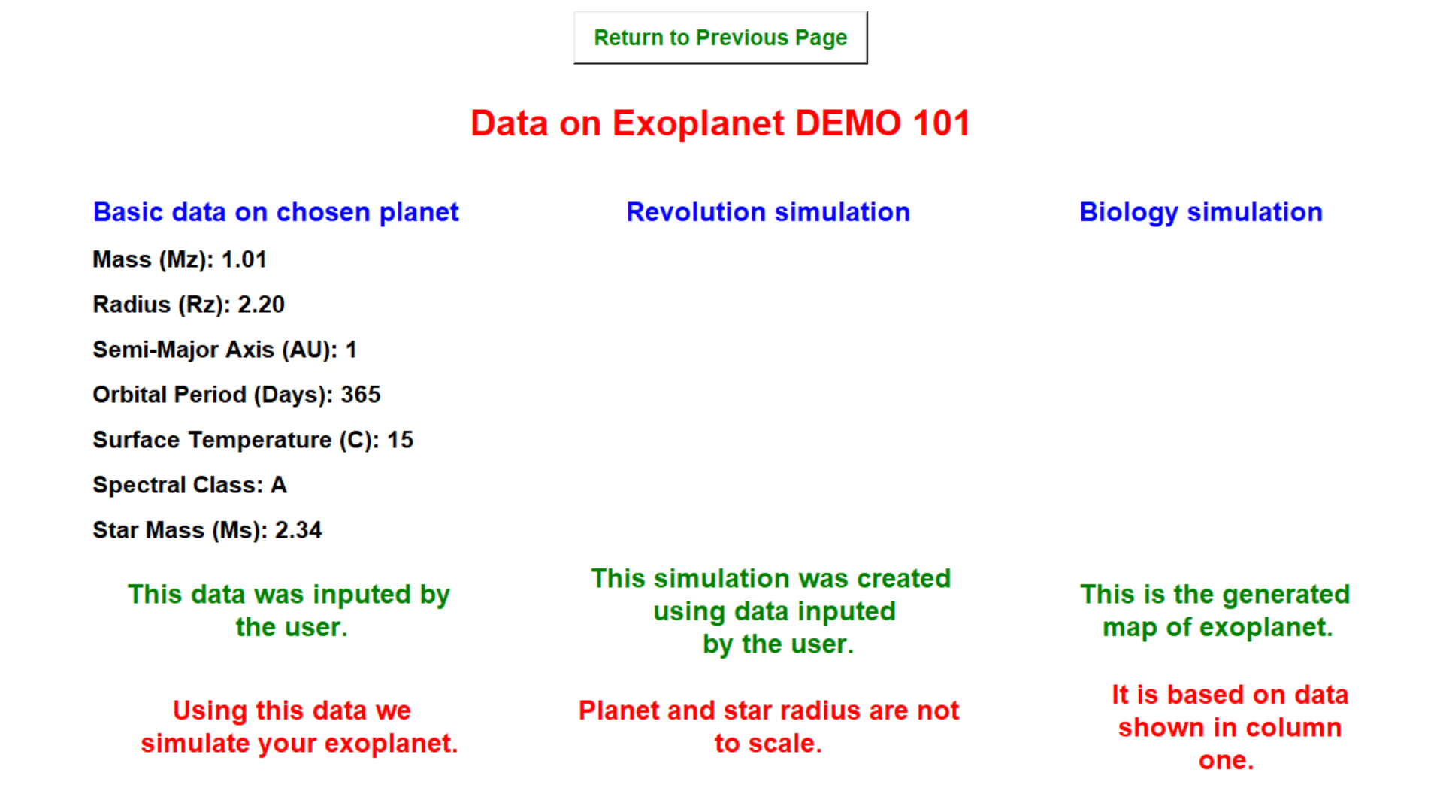
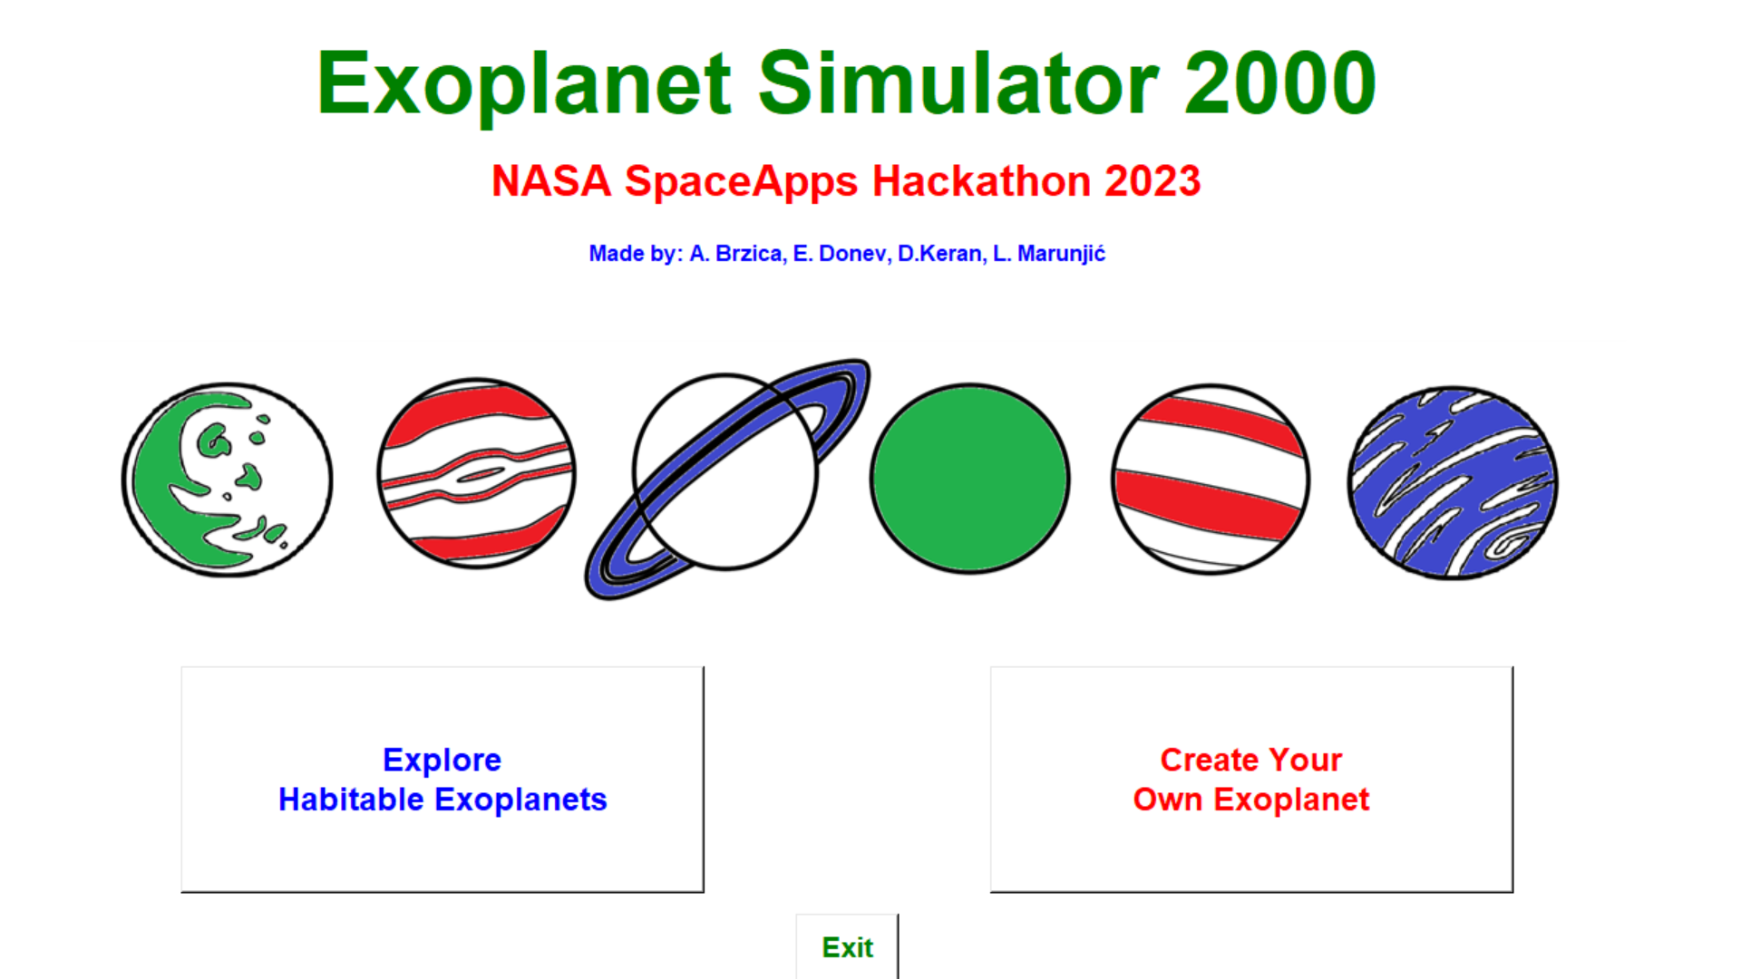
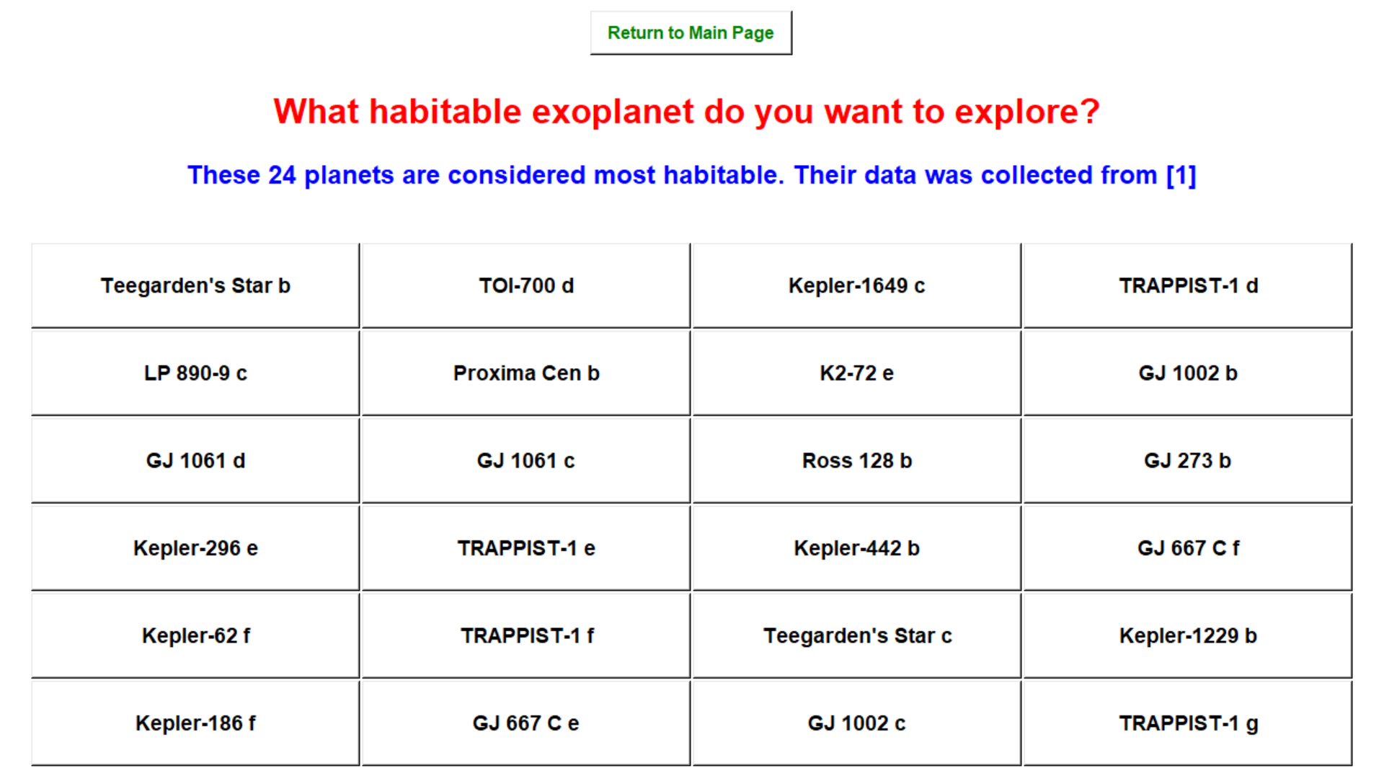
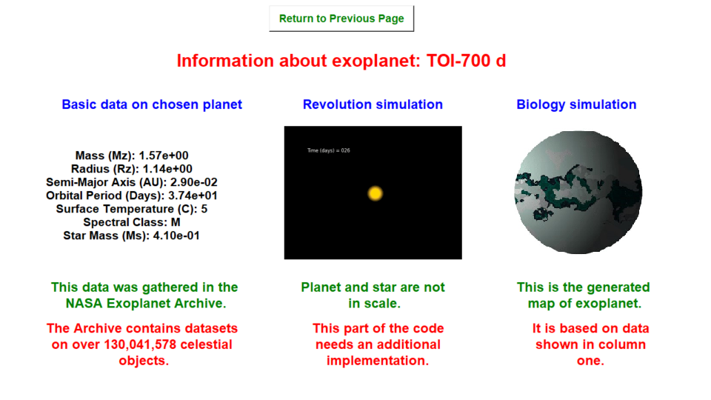
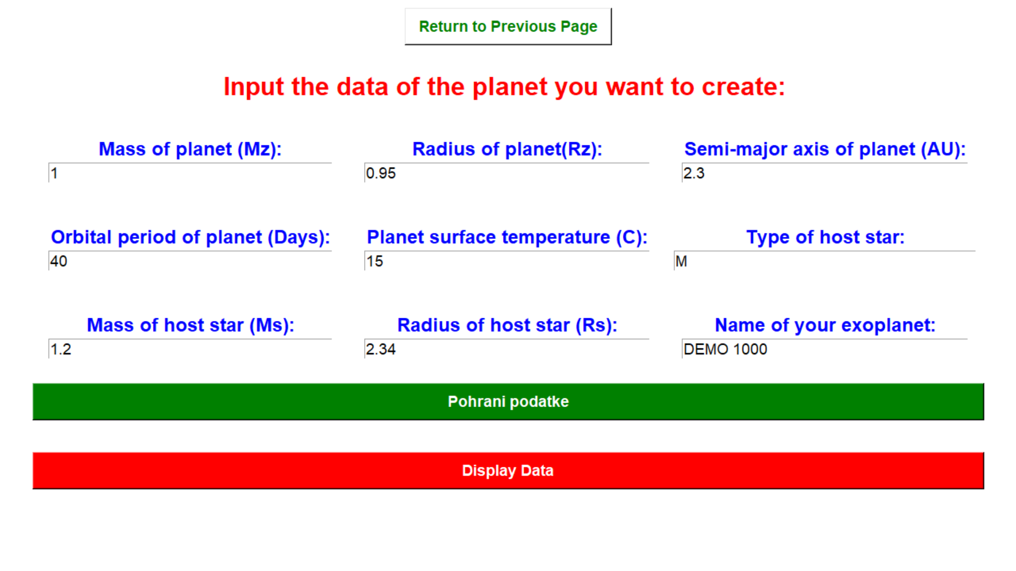
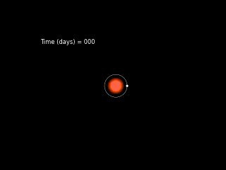
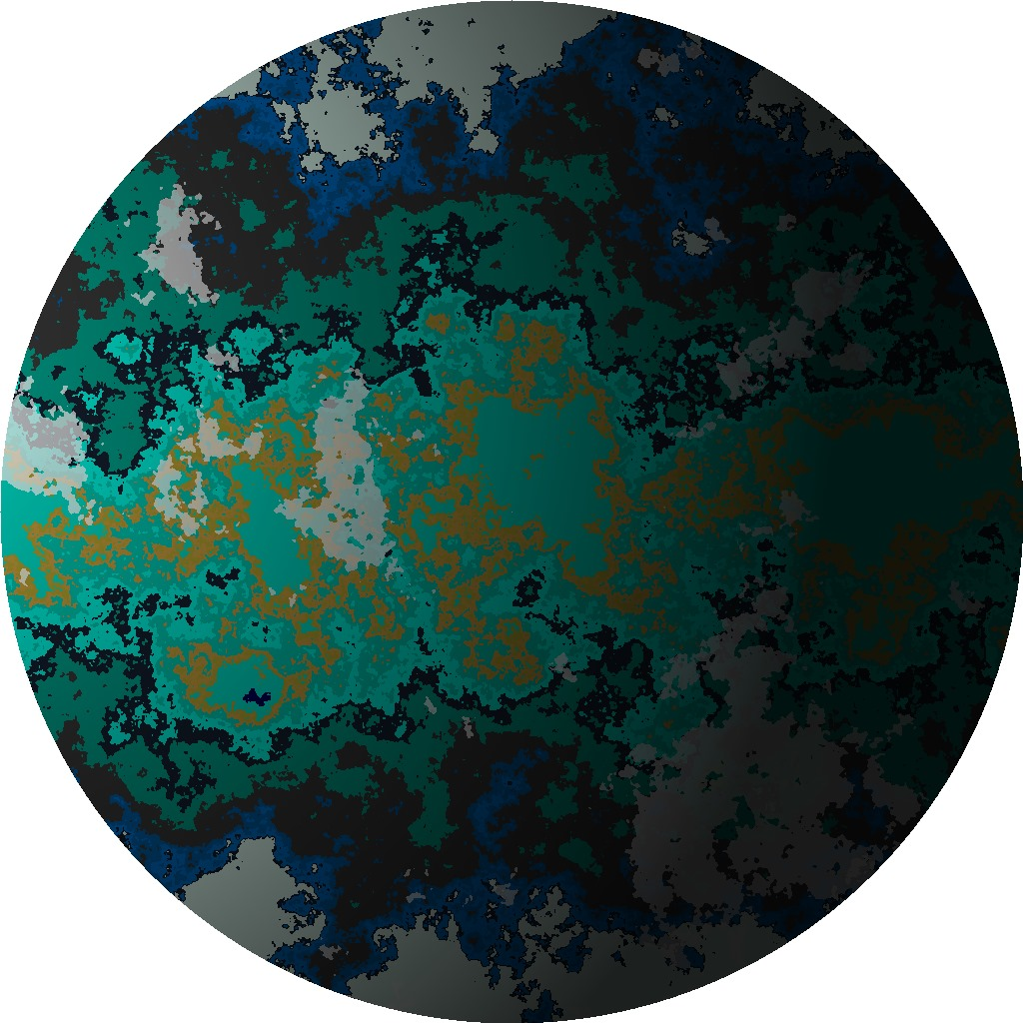

Slide 7
Thank you for attention!
Resources:
[1] https://exoplanetarchive.ipac.caltech.edu/
[2] https://phl.upr.edu/projects/habitable-exoplanets-catalog
[3] https://github.com/KornelSzyszka/PlanetGenerator

